Slide 1




LUXURY HOTEL
THE STAY THAT STAYS WITH YOU

Slide 2



TEAM
GROUP 5
Akhilesh Ashok Shahapurkar
Sudama Rangappa Talwar
Pavan Vilas Wadurkar

Slide 3
PROJECT TIME LINE
Review 1
July 27-2025
Review 2
Aug 3-2025
Review 3
Aug 17-2025
Final Review
Aug 24-2025
Introduced interactive Excel dashboards and finalized KPIs, incorporating stakeholder feedback.
Created interactive dashboard in Tableau, showcasing advanced visualizations.
Created interactive dashboards in Power BI, showcasing advanced visualizations.
In final review meeting we will present the complete project outcome, including MYSQL query’s, Interactive dashboard’s in power BI, Tableau, along with the finalized KPI. Also walk through the prepared presentations .
Final Review Aug 24 - 2025

Slide 4
INTRODUCTION
Shodwe Group, a Big-sized hospitality chain with properties across India, USA, UAE was struggling with fragmented and delayed reporting.
The Hospitality Analysis Dashboard is designed to provide end-to-end visibility into hotel operations and guest behavior, empowering stakeholders—including revenue managers, operations teams, and executives—to make data-driven decisions. The dashboard monitors key performance indicators (KPIs), including Total Revenue, Occupancy Rate, Cancellation Rate, Booking Trends, and Utilizations Metrics, as well as advanced insights such as Customer Segmentation, Revenue by Location and Room Type, and a Weekday vs. Weekend Performance Analysis

Slide 5
DATA OVERVIEW
Source: Hospitality Dataset provides sample datasets which include 5 tables like bookings, aggregated bookings, hotels, rooms, date.
Data Points: Sales data, Product details, Customer information, and Regional insights.
Volume: Rows-1,34,000+, Columns – 16
Timeline of Data July 2022

Slide 6
DATASET INFORMATION
About | Description
Domain | Hospitality / Hotel Management
Project | Hospitality Analysis Project
Datasets Used | fact_bookings, fact_aggregated_bookings, dim_hotels, dim_rooms, dim_date
Dataset Type | Comma Separated Values(.csv) Format
Dataset Size | 14.5 MB

Slide 7
Business Problem
How can Shodwe Group optimize room bookings and Profitability across different Territories and Customer Segments.”
To analyze and Identify:
Which Product and Category are performing Best/Worst?
Which Sales Territories are underperforming?
What are Customer Booking patterns?
How seasonality and Demographics affect buying patterns?

Slide 8
KPI’s
1) REVENUE GENERATED
2) REVENUE REALIZED
3) TOTAL CUSTOMERS
4) TOTAL BOOKINGS
5) OCCUPANCY RATE
6) TOTAL GUEST VISITED
7) NO SHOW RATE
8) CHECKED OUT RATE
9) ROOM CAPACITY
10) AVERAGE DISCOUNTS
11) CANCELLATION RATE
12) AVERAGE RATINGS
13) AVG AGE OF THE CUSTOMERS

Slide 9
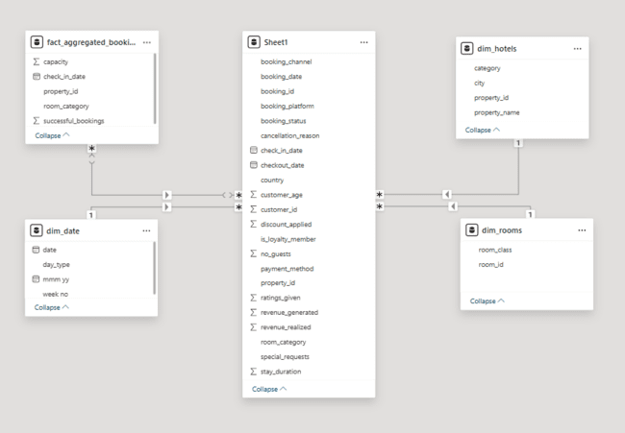
DATA MODELING

Slide 10
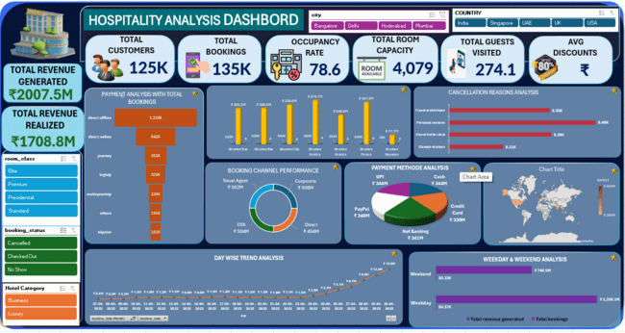
EXCEL DASHBOARD

Slide 11
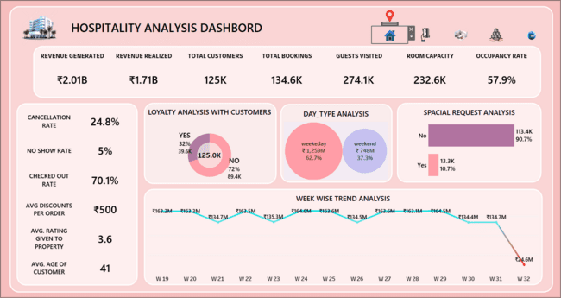
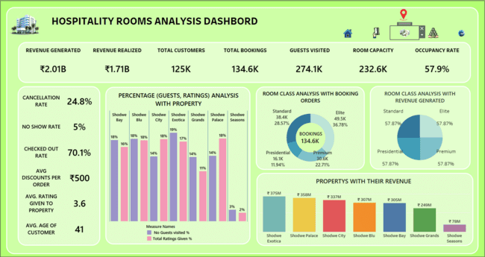
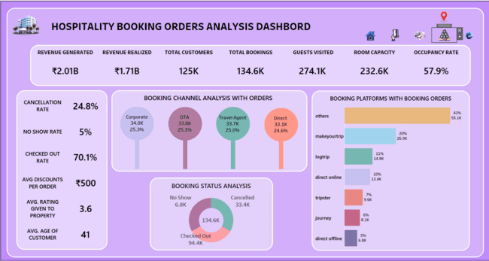
TABLEAU DASHBOARD

Slide 12
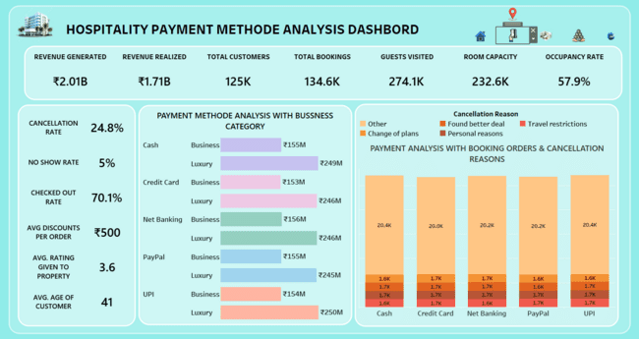
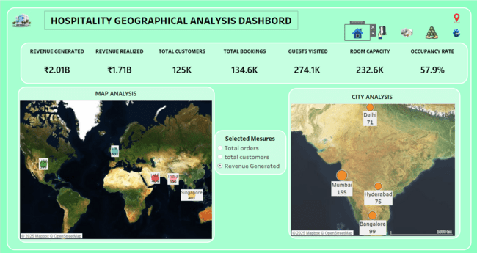
TABLEAU DASHBOARD

Slide 13
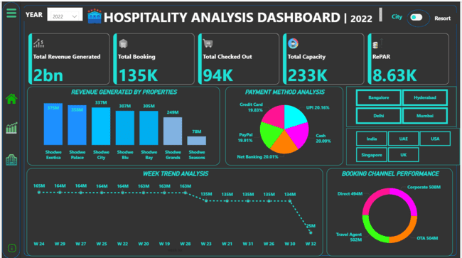
POWER BI DASHBOARD

Slide 14
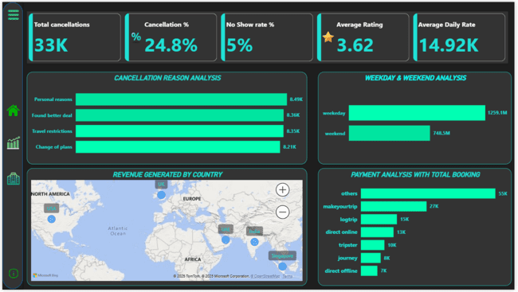

Slide 15
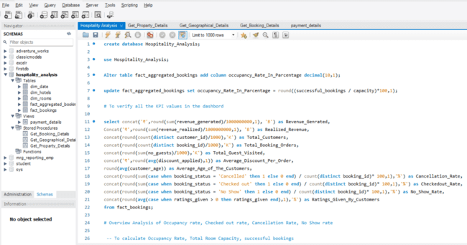
MYSQL QUERY’S

Slide 16
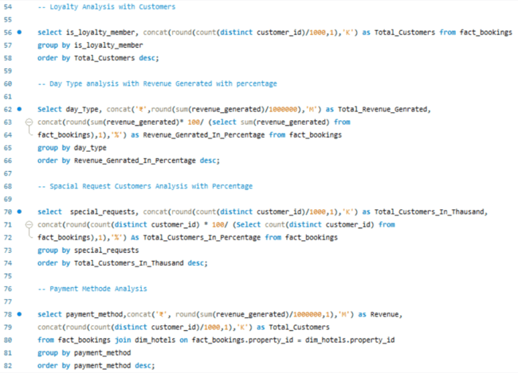
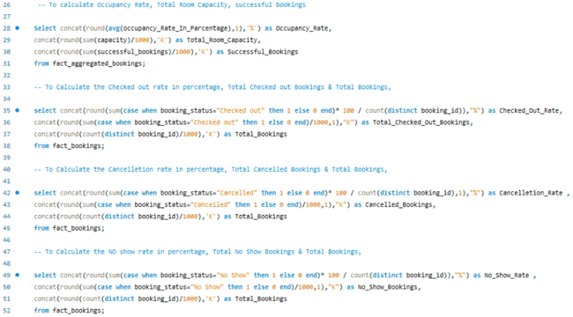
MYSQL QUERY’S

Slide 17
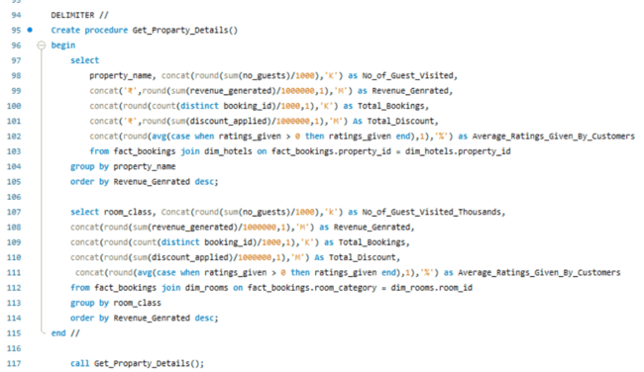
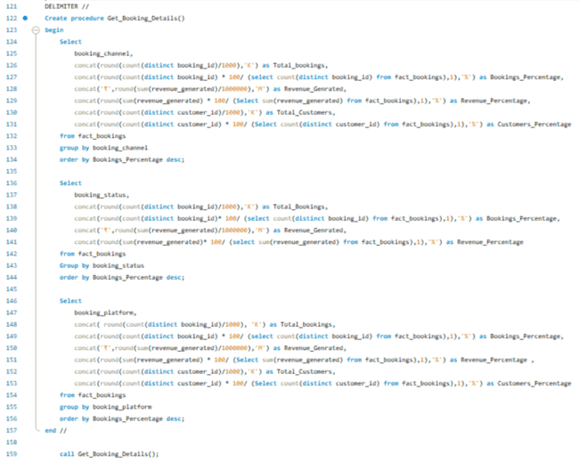
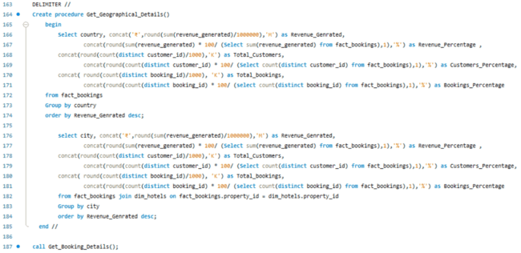

Slide 18
IMPACT OF PROJECT
"IMPACT OF DATA ANALYSIS ON BUSINESS"
IMPROVED DECISION-MAKING: THE ANALYSIS HELPED LEADERSHIP MAKE INFORMED DECISIONS ON PRODUCT STRATEGIES AND REGIONAL SALES FOCUS.
COST REDUCTION: IDENTIFYING INEFFICIENCIES IN PRODUCTION AND LOGISTICS HELPED REDUCE COSTS.
CUSTOMER-CENTRIC APPROACH: INSIGHTS LED TO BETTER CUSTOMER SEGMENTATION AND TARGETED MARKETING.
INCREASE TRUST: Increases stakeholders' confidence through transparency, evidence-based analysis and reporting with proper reporting.
Supports risk management by predicting potential issues and enabling proactive solutions…

Slide 19
CHALLENGES ENCOUNTERED
DATA QUALITY: THERE WERE MULTIPLE DATA SETS WHERE THE FORMAT OF THE DATA WERE DIFFERENT WHICH HAD TO BE CORRECTED AND FILTERED ALONG WITH FILLING OUT THE NULL VALUES IN THE SHEETS.
DATA MODELLING: THERE WERE 2 SETS OF BOOKING DATA WHICH HAD TO BE APPENDED AND THEN HOTELS, ROOMS AND DATE TABLES WERE LINKED TO EACH OTHER.
INTEGRATION ISSUES: COMBINING DATA FROM DIFFERENT SOURCES (SQL DATABASE, EXCEL FILES) POSED CHALLENGES.
COMPLEXITY: CREATING A COHESIVE DASHBOARD THAT REPRESENTED ALL KPIS WAS A COMPLEX TASK….

Slide 20
RECOMMENDATIONS
TARGET BEST CUSTOMERS: FOCUS ON HIGH-VALUE CUSTOMERS AND OFFER LOYALTY PROGRAMS.
IMPLEMENT CLEAR CANCELLATION POLICIES: TRY TO IMPLEMENT DEADLINES FOR CANCELLATION TO REDUCE HIGH CANCELLATION RATE.
MARKET FOCUS: INVEST MORE IN EXPANDING OPERATIONS AND MARKETING IN ASIA, WHERE SALES POTENTIAL IS HIGH.
GIVE MORE DISCOUNTS: AS AVG.DICOUNT IS ONLY Rs. 500.
TAP OTHER MARKETS ALSO : FOCUS ON INDIA AS ITS REVENUE EQUALS TO UAE & UK BUT ALSO SOUTH AMERICA, EUROPE, AFRICAN CONTINENT….

Slide 21
LEARNINGS
AS THE PROJECT IS A TEAMWORK, UNDERSTANDING AND KNOWING PEOPLE AND THEIR SKILLSET IS IMPORTANT IN ORDER TO WORK TOGETHER EFFICIENTLY AND BRING OUT THE BEST RESULTS.
UNDERSTANDING THE DATA: NEED TO SPEND MORE TIME IN READING AND UNDERSTANDING THE DATA SET RATHER STARTING TO BUILD DASHBOARD WHICH WILL HELP US IN UNDERSTANDING THE NEED AND REQUIREMENT AND VISUALISE AND PRESENT IT EFFECTIVELY.
DATA CLEANING IS CRUCIAL: ENSURING DATA QUALITY IS FOUNDATIONAL TO GETTING ACCURATE INSIGHTS.
WEEKLY REVIEWS: TO EVALUATE OUR LEARNINGS AND UPGRADE OURSELVES BY CORRECTING THE MISTAKES AND LEARN MORE FROM OTHERS AND IMPLEMENT IT IN NEXT REVIEW.
VISUALIZATION SKILLS: MASTERING TOOLS LIKE TABLEAU AND POWER BI ENHANCES THE ABILITY TO COMMUNICATE DATA EFFECTIVELY.
SQL PROFICIENCY: WRITING COMPLEX QUERIES WAS ESSENTIAL TO EXTRACTING RELEVANT DATA FOR ANALYSIS….

Slide 22


